Slide 1
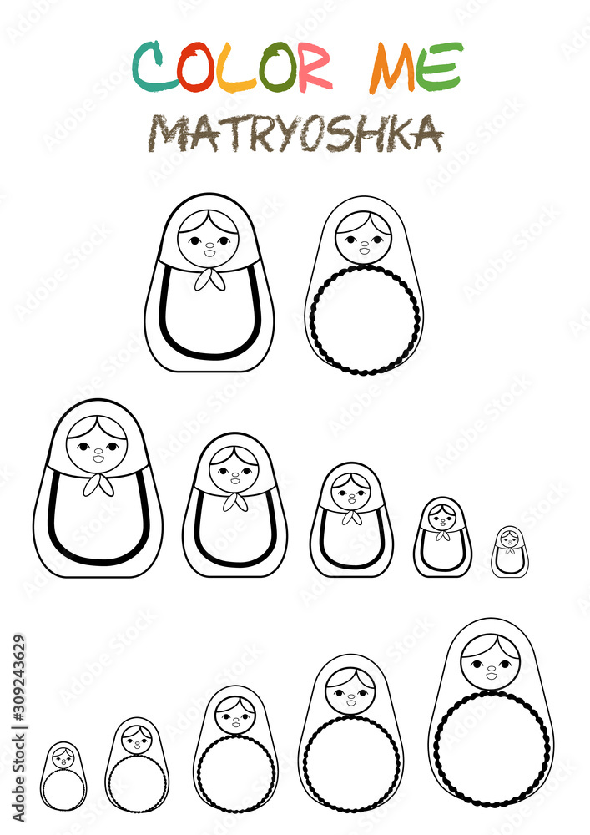
Women
Mothers
Grandmothers
Women
Great-grandmothers
Mothers
Grand
mothers
Great-
grand
mothers

Slide 2
Woman
Woman
Woman
A | 1 | 2 | 3
0
1
2
B | 1 | 2 | 3
0
1
2
C | 1 | 2 | 3
0
1
2
Age

